Slide 1
SMART HELMET FOR UNDER GROUND MINING PEPOLE
Team members:
Bodapati Anjali:9921005314@klu.ac.in
Gandham Saranya Thejaswi:9921005298@klu.ac.in
Avula Ram Teja:9921005324@klu.ac.in
Team number VH133

Slide 2
Content
OBJECTIVE
ABRSTRACT
INTRODUCTION
LITERATURE SURVEY
EXISTING METODOLOGY
PRPOSED SYSTEM
BLOCK DIAGRAM
COMPONENTS REQUIRED
RESULT
CONCULISON
REFRENCE

Slide 3
Objective
To help the coal miners inside the mines to communicate with the outside world.
➢ To monitor the conditions inside the mines in case of emergency.
➢ Detection of the poisonous gases.
➢ Alerting the miners whenever the helmet is removed.
➢ Transmitting data through ZigBee Module.
➢ Receiving Transmitting data through ZigBee Module.
➢ To monitor Hazardous gases like CO, SO2, NO2, CO, LPG etc.
➢ Detection of head injuries
➢ Collision with the heavy objects

Slide 4
ABSTRACT
A smart helmet has been created for miners, equipped with various functions such as two-way communication, detection of hazardous gases, alert notifications for helmet removal, collisions, and emergency situations. It also continuously monitors environmental conditions such as temperature and pressure, and includes GPS for tracking miner locations. If poisonous gas is detected, the helmet's opening closes and oxygen is supplied from a cylinder. A panic switch alerts the control room during emergencies, and temperature and pressure sensors provide ongoing data through wireless networks.

Slide 5
Introduction
Our project intends to create wireless sensor networks, implement real-time surveillance with early-warning intelligence on dangerous gases, temperature, and humidity in mining areas, and employ ZigBee communication to eliminate potential safety issues in coal extraction.
All three parameters are continuously monitored by temperature sensors, gas sensors, and humidity sensors, and if they exceed a pre-set threshold, the user is notified by a buzzer with LED indicators.
The system might be simply expanded using ZigBee Wireless locating devices.
The ZigBee transmitter continuously transmits the values of various sensors to the remote monitoring unit, which is received by the ZigBee receiver module

Slide 6
Literature Survey
"Smart Helmet for Coal Miners using Zigbee Technology" by IJIRST - International Journal for Innovative Research in Science & Technology, Vol. 1, Issue 9, pp. 278-281, 2015. The paper presents a smart helmet for coal miners that uses Zigbee technology and Arduino Uno. The helmet is equipped with sensors to monitor the miner's vital signs, temperature, and environmental conditions such as gas levels and humidity. The data from the sensors is transmitted to a central server for real-time monitoring and analysis.
"Smart Helmet for Mining Safety" by K. Rajkumar and G. Sivasankar in International Journal of Emerging Trends in Engineering and Development, Vol. 5, Issue 5, pp. 160-165, 2014. This paper describes the development of a smart helmet for mining safety using Arduino Uno.

Slide 7
Literature Survey
"Design and Implementation of an Intelligent Helmet for Miners" by J.A. Adu-Gyamfi, F. Oduro and A.A. Adetunji in International Journal of Scientific and Research Publications, Vol. 3, Issue 2, pp. 1-7, 2013. The paper describes the design and implementation of an intelligent helmet for miners using Arduino Uno and Zigbee wireless communication. The helmet is equipped with sensors to monitor gas levels, temperature, and humidity. The data from the sensors is transmitted to a central server for real-time monitoring and analysis
"Smart Helmet for Mining Safety" by K. Rajkumar and G. Sivasankar in International Journal of Emerging Trends in Engineering and Development, Vol. 5, Issue 5, pp. 160-165, 2014. The paper describes the development of a smart helmet for mining safety using Arduino Uno. The helmet is equipped with sensors to monitor gas levels, temperature, humidity, and heart rate. The data from the sensors is transmitted to a central server for real-time monitoring and analysis.

Slide 8
EXISTING METODOLOGY
Good blood glucose control and control of blood pressure and elevated lipids reduces the risk of new-onset diabetic retinopathy and slows progression of existing diabetic retinopathy.
This approach should underpin the prevention and treatment of diabetic retinopathy in all people with diabetes. Laser treatment is the mainstay of treatment for proliferative diabetic retinopathy and can also be used for the treatment of diabetic macular oedema.
Anti-VEGF (vascular endothelial growth factor) agents and steroids injected into the eye can reduce the progression of the disease and preserve visual function in diabetic macular oedem.
There are several anti-VEGF agents, and bevacizumab is included in the WHO Model List of Essential Medicines
Vitrectomy can restore useful vision in eyes with non-resolving vitreous haemorrhage and traction retinal detachment of the macula

Slide 9
PROPOSED SYSTEM
To develop an embedded system to monitor harmful emissions in the coal mines like CO2, LPG and it is also used to control the temperature and humidity.
Coal mine emission parameter like CO2, LPG etc. can be continuously monitored by using Gas sensor, temperature monitored by temperature sensor, and humidity is monitored by humidity sensor.
The hardware is placed inside the coal mines. Whenever poison gases, fire are detected by the sensors connected to the micro controller, will give buzzer for alert & transmits the data through ZigBee.
The transmitted data will be received by the ZigBee receiver and this information will be passed to the higher authorities and emergency services by using GSM module.

Slide 10
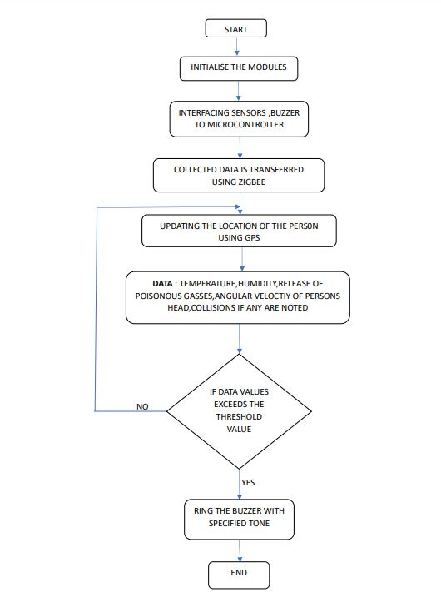
FLOW CHART
-

Slide 11
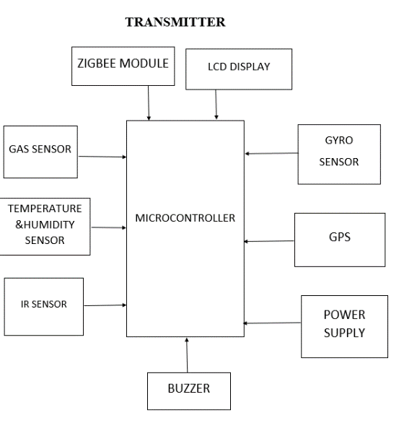
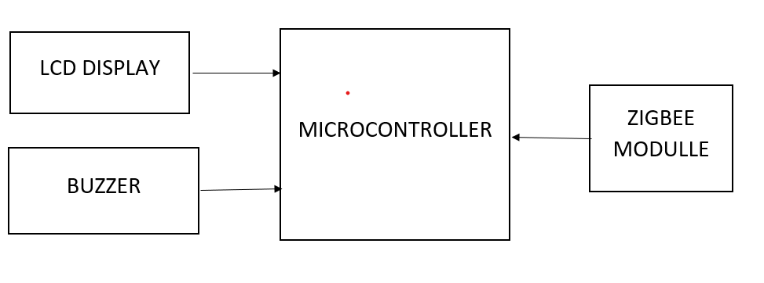
BLOCK DIAGRAM
RECEIVER

Slide 12
Components Required
ZIGBEE Module
JHD162A LCD MODULE
DHT11 TEMPERATURE
ARDUINO UNO
GY GPS-6MV2
GYRO ADX1345
IR SENSOR

Slide 13
Software required
Arduino IDE 1.8.19 Version
C ++
Teachable Machine Learning System

Slide 14
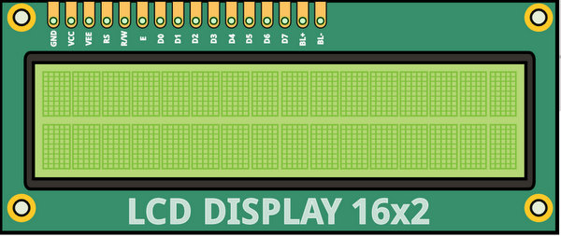
JHD162A
The term LCD stands for liquid crystal display. It is one kind of electronic display module used in an extensive range of applications like various circuits & devices like mobile phones, calculators, computers, TV sets, etc. These displays are mainly preferred for multi-segment light-emitting diodes and seven segments. The main benefits of using this module are inexpensive.
LCD display module with Yellow Backlight
SIZE : 2 Rows and 16 Characters Per Row
Can display 2-lines X 16-characters
Operate with 5V DC
Wide viewing angle and high contrast
Built-in industry standard HD44780 equivalent LCD controller

Slide 15
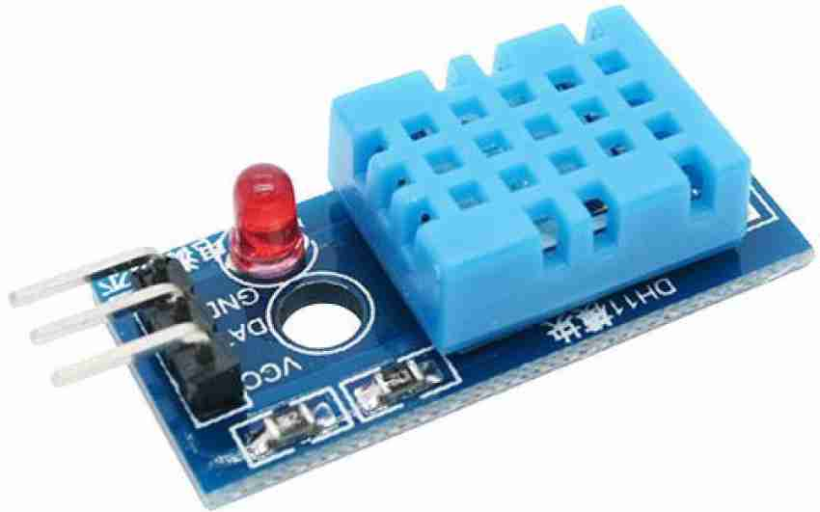
DHT11 Temperature
DHT11 is a low-cost digital sensor for sensing temperature and humidity. This sensor can be easily interfaced with any micro-controller such as Arduino, Raspberry Pi etc.… to measure humidity and temperature instantaneously.
DHT11 humidity and temperature sensor is available as a sensor and as a module. The difference between this sensor and module is the pull-up resistor and a power-on LED. DHT11 is a relative humidity sensor. To measure the surrounding air this sensor uses a thermistor and a capacitive humidity sensor.
APPLICATIONS :
This sensor is used in various applications such as measuring humidity and temperature values in heating, ventilation and air conditioning systems. Weather stations also use these sensors to predict weather conditions. The humidity sensor is used as a preventive measure in homes where people are affected by humidity. Offices, cars, museums, greenhouses and industries use this sensor for measuring humidity values and as a safety measure.

Slide 16
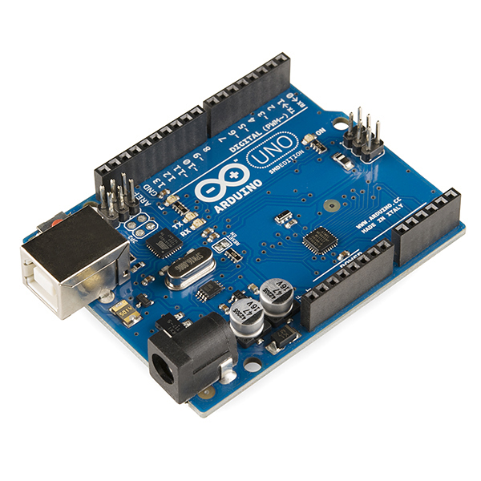
Arduino Uno
The Arduino Uno ATmega328 offers UART TTL-serial communication, and it is accessible on digital pins like TX (1) and RX (0). The software of an Arduino has a serial monitor that permits easy data. There are two LEDs on the board like RX & TX which will blink whenever data is being broadcasted through the USB.

Slide 17
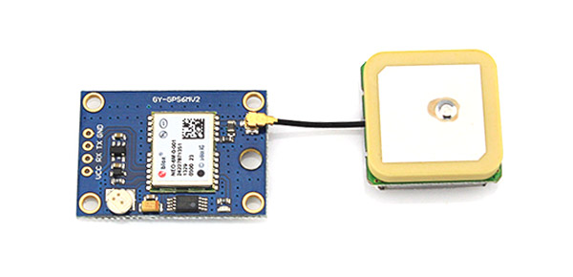
GY GPS-6MV2
The module GND pin is connected to Arduino GND pin
The module RX pin is connected to Arduino pin 3
The module TX pin is connected to Arduino pin 4
The module VCC pin is connected to Arduino 5V pin
This module has an external antenna and built-in EEPROM.
Interface: RS232 TTL
Power supply: 3V to 5V
Default baud rate: 9600 bps
Works with standard NMEA sentences

Slide 18
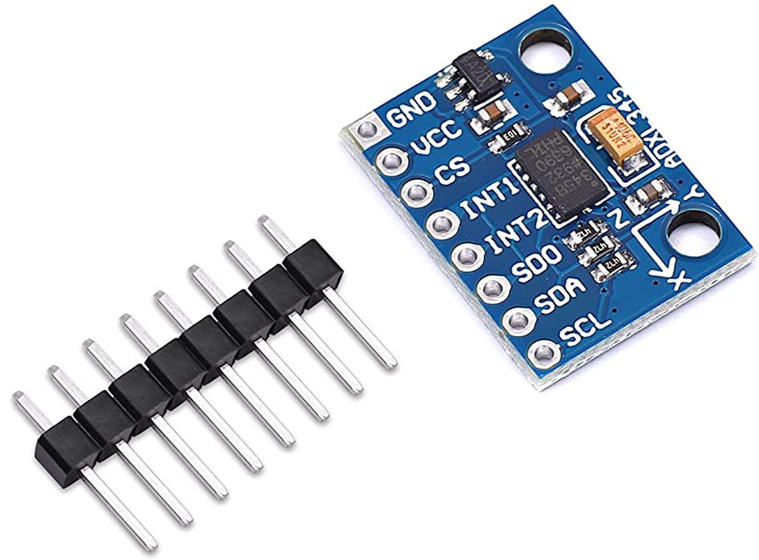
GYRO ADX1345
The ADXL345 sensor works.
This is a 3-axis accelerometer which can measure both static
and dynamic forces of acceleration.
The earth gravitational force is a typical example of static force,
while dynamic forces can be caused by vibrations,
The unit of measurement for acceleration is meter per second
squared (m/s^2). However, accelerometer sensors usually
express the measurements in “g” or gravity.
One “g” is the value of the earth gravitational force which is equal
to 9.8 meters per second squared.

Slide 19
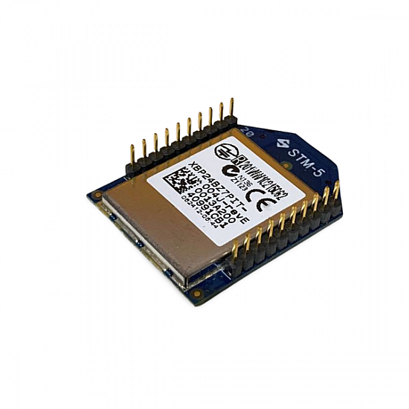
ZIGBEE
ZigBee is a standards-based wireless technology developed to enable low-cost, low-power wireless machine-to-machine (M2M) and internet of things (IoT) networks. ZigBee is for low-data rate, low-power applications and is an open standard.

Slide 20
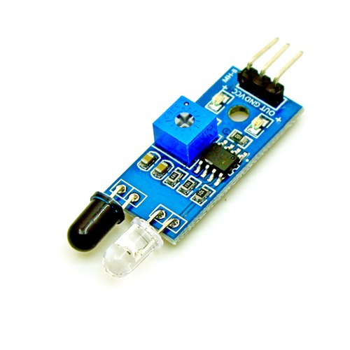
IR SENSOR
The IR transmitter continuously emits the IR light
and the IR receiver keeps on checking for the
reflected light. If the light gets reflected back
by hitting any object in front it, the IR
receiver receives this light. This way the
object is detected in the case of the IR sensor.

Slide 21
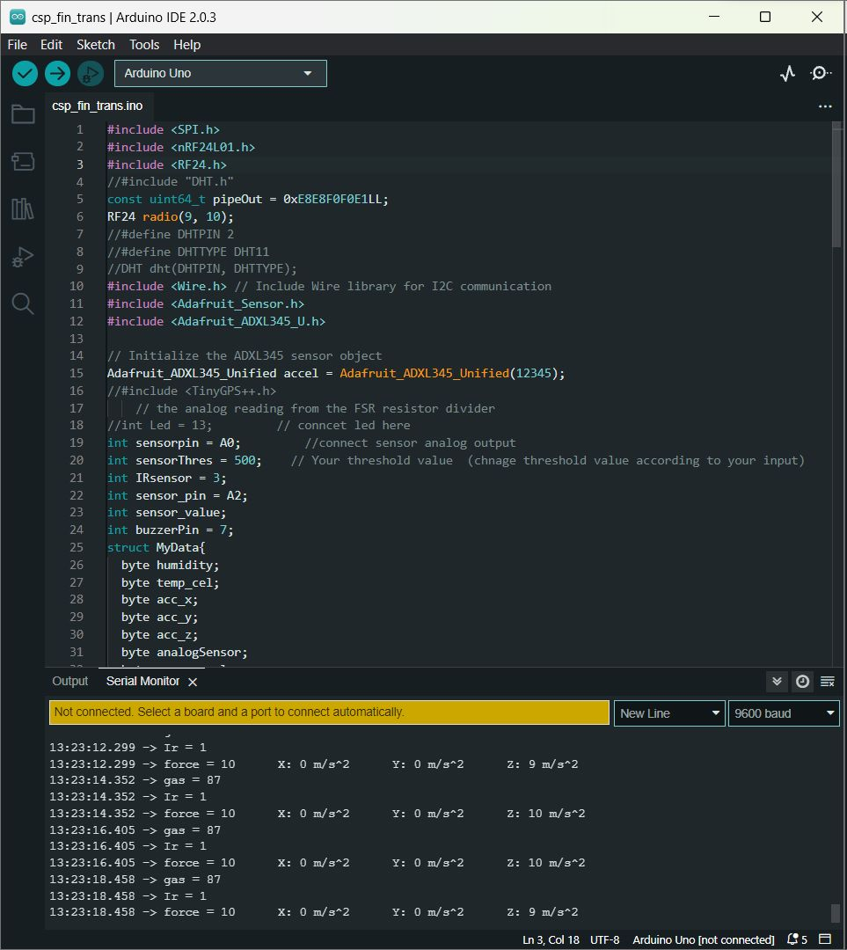
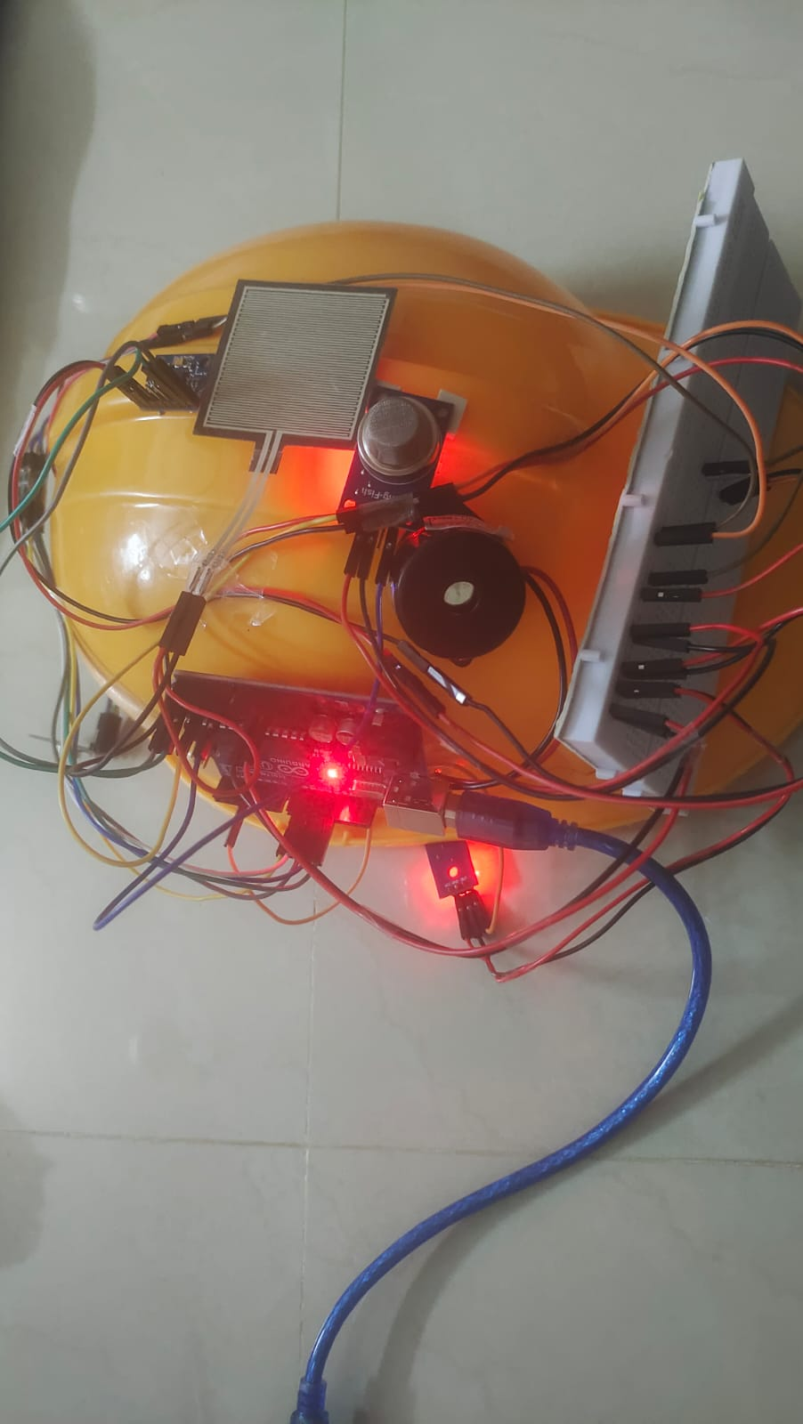
Result:

Slide 22
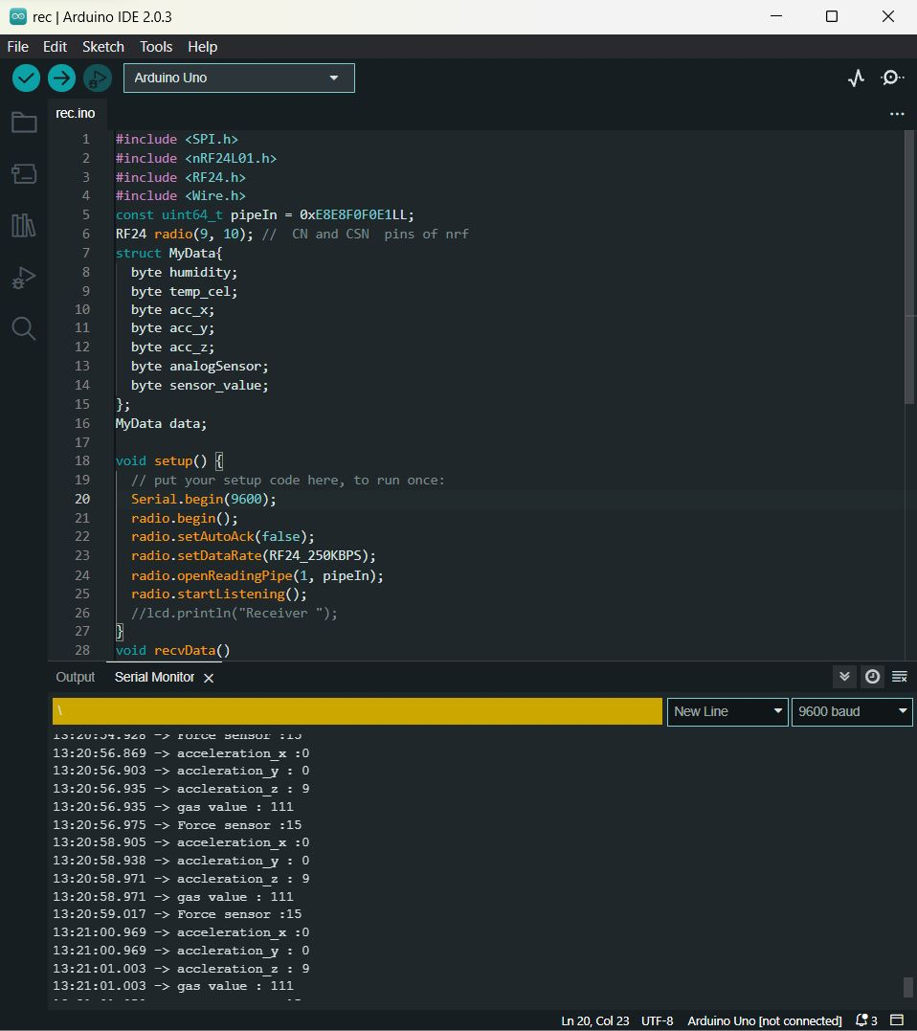
RESULT
RECIVER SIDE :

Slide 23
Conclusion
A smart helmet has been developed for detecting hazardous events, monitoring the surrounding environmental conditions, and sending updates such as GPS location and sensor data to the central console for easy tracking. The helmet is also equipped to provide oxygen supplements to prevent inhalation of poisonous gases. The system can be expanded further by incorporating Internet of Things (IoT) technology. A database can be established to continuously monitor the sensor modules.

Slide 24
References
➢ Srivastava, S. K. (2015). Real time monitoring system for mine safety using wireless sensor network . ➢ Kumar, A., & Hancke, G. P. (2014). Energy efficient environment monitoring system based on the IEEE 802.15. 4 Standard for low cost requirements.
➢ "Design and Implementation of an Intelligent Helmet for Miners" by J.A. Adu-Gyamfi, F. Oduro and A.A. Adetunji in International Journal of Scientific and Research Publications, Vol. 3, Issue 2, pp. 1-7, 2013. This paper describes the design and implementation of an intelligent helmet for miners using Arduino Uno.
➢ "Smart Helmet for Mining Safety" by K. Rajkumar and G. Sivasankar in International Journal of Emerging Trends in Engineering and Development, Vol. 5, Issue 5, pp. 160-165, 2014. This paper describes the development of a smart helmet for mining safety using Arduino Uno

